Slide 1
Distributed Computing Consensus and Agreement Algorithms
Dr. Barsha Mitra
CSIS Dept, BITS Pilani, Hyderabad Campus

Slide 2
Introduction
agreement among processes in a distributed system is a fundamental requirement for a wide range of applications
processes need to exchange information to negotiate with one another and eventually reach a common understanding or agreement, before taking actions

Slide 3
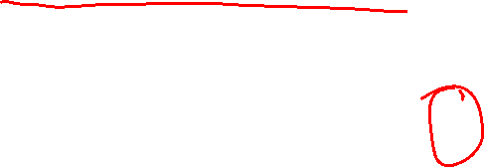
Assumptions for Agreement Algorithms
Failure models
among the n processes in the system, at most f processes can be faulty
faulty process can behave in any manner allowed by the failure model assumed
various failure models –
fail-stop
Byzantine failures

Slide 4

Assumptions for Agreement Algorithms
Failure models
Fail-stop model –
a process may crash in the middle of a step
a step could be the execution of a local operation or processing of a message for a send or receive event
a process may send a message to only a subset of the destination set before crashing
Byzantine failure model - a process may behave arbitrarily

Slide 5
Assumptions for Agreement Algorithms
Synchronous/Asynchronous communication
if a failure-prone process chooses to send a message to process P_{i} but fails, then P_{i} cannot detect the non-arrival of the message in an asynchronous system
scenario is indistinguishable from the scenario in which the message takes a very long time to travel
impossible to reach a consensus in asynchronous systems

Slide 6

Assumptions for Agreement Algorithms
Synchronous/Asynchronous communication (contd..)
synchronous system –
a message that has not been sent can be recognized by the intended recipient, at the end of the round
intended recipient can deal with the non-arrival of the expected message by assuming the arrival of a message containing some default data, and then proceeding with the next round of the algorithm
Network connectivity
system has full connectivity, i.e., each process can communicate with any other by direct message passing

Slide 7
Assumptions for Agreement Algorithms
Sender identification
a process receiving a message always knows identity of sender process
also true for malicious senders
Channel reliability
channels are reliable
only the processes may fail (under one of various failure models)
Agreement variable
agreement variable
may be boolean or multivalued
need not be an integer

Slide 8
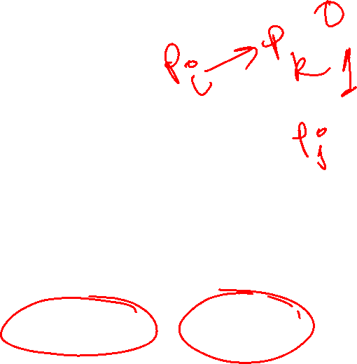
Assumptions for Agreement Algorithms
Non-authenticated messages
with unauthenticated messages, when a faulty process relays a message to other processes
it can forge the message and claim that it was received from another process
it can also tamper with the contents of a received message before relaying it
receiver cannot verify its authenticity
unauthenticated message is also called oral message or unsigned message

Slide 9

Assumptions for Agreement Algorithms
Authenticated messages
using authentication via techniques such as digital signatures
if some process forges a message or tampers with the contents of a received message before relaying it, the recipient can detect the forgery or tampering

Slide 10
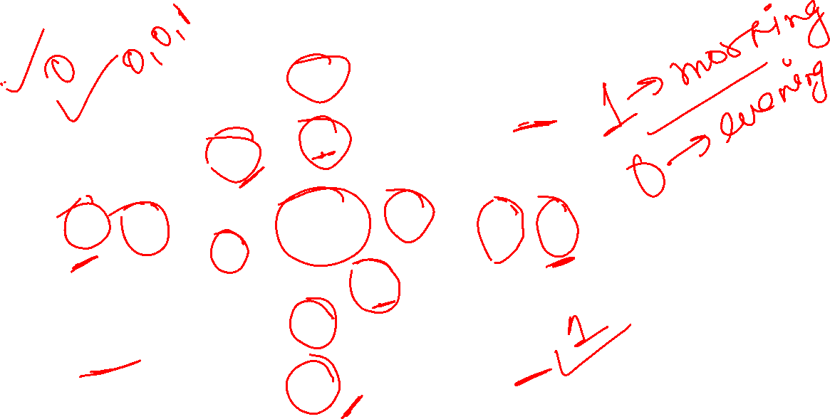
Byzantine Agreement Problem

Slide 11
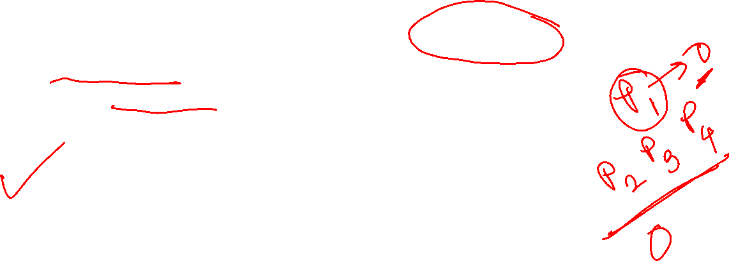
Byzantine Agreement Problem
requires a designated process, called the source process, with an initial value, to reach agreement with the other processes about its initial value, subject to the following conditions:
Agreement: all non-faulty processes must agree on the same value
Validity: if the source process is non-faulty, then the agreed upon value by all the non-faulty processes must be the same as the initial value of the source
Termination: each non-faulty process must eventually decide on a value

Slide 12

Byzantine Agreement Problem
if the source process is faulty, then the correct processes can agree upon any default value
irrelevant what the faulty processes agree upon – or whether they terminate and agree upon anything at all

Slide 13
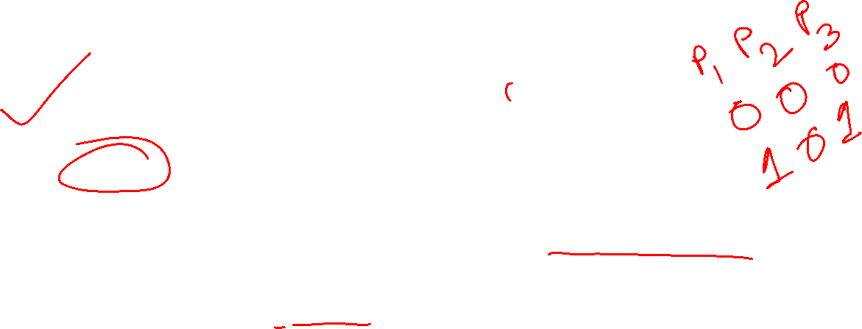
Consensus Problem
Initiated by all processes
Agreement: all non-faulty processes must agree on the same (single) value
Validity:
if all the non-faulty processes have the same initial value, then the agreed upon value by all the non-faulty processes must be that same value
if non-fault processes broadcast different initial values, then these processes should decide upon a common value
Termination: each non-faulty process must eventually decide on a value

Slide 14
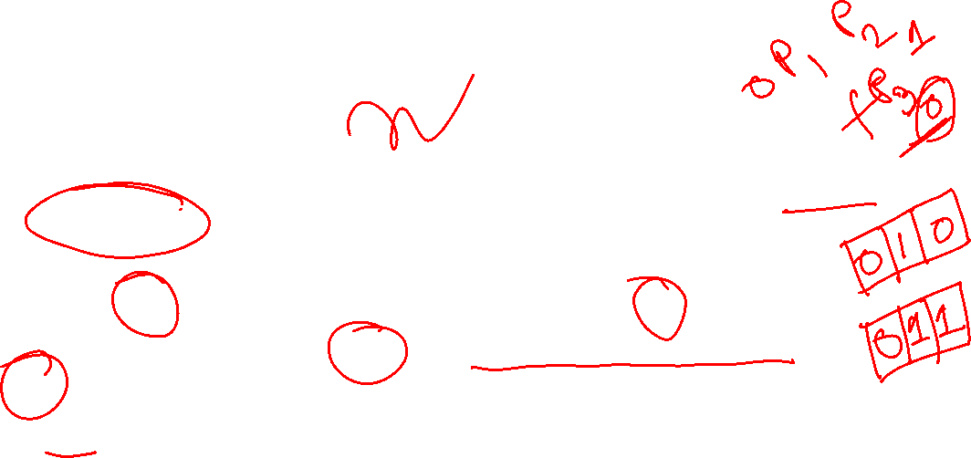
Interactive Consistency Problem
Initiated by all processes
Agreement: all non-faulty processes must agree on the same array of values A[v₁…v_{n}]
Validity:
if process P_{i} is non-faulty and its initial value is v_{i}, then all non-faulty processes agree on v_{i} as the i^{th} element of the array A
if P_{j} is faulty, then the non-faulty processes can agree on any value for A[j]
Termination: each non-faulty process must eventually decide on the array A

Slide 15
Equivalence of the Problems
3 problems are equivalent
a solution to any one of them can be used as a solution to the other 2 problems

Slide 16
Agreement in a Failure-free System
consensus can be reached by collecting information from the different processes, arriving at a “decision,” and distributing this decision in the system
a distributed mechanism would have each process broadcast its values to others, and each process computes the same function on the values received
decision can be reached by using an application specific function – majority, max, and min functions
direct communication with all nodes

Slide 17

Agreement in a Failure-free System
synchronous system -
can be done in a constant number of rounds
common knowledge of the decision value can be obtained using an additional round
asynchronous system –
consensus can be reached in a constant number of message hops
concurrent common knowledge of the consensus value can be attained using an additional algorithm

Slide 18
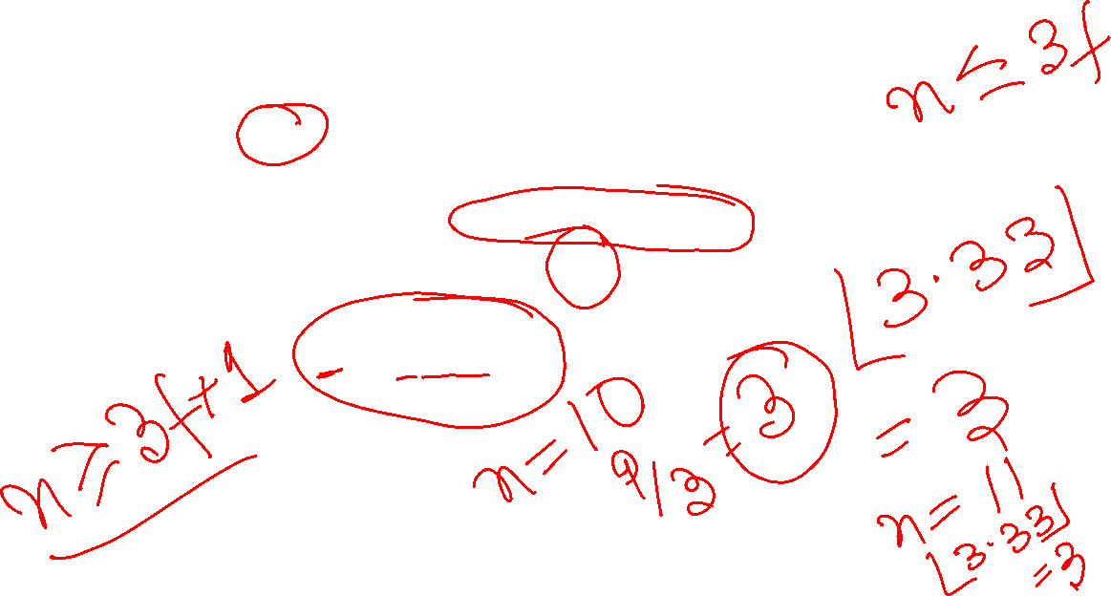
Upper Bound on Byzantine Processes
in a system of n processes, the Byzantine agreement problem (and the other variants of the agreement problem) can be solved in a synchronous system only if the number of Byzantine processes f is such that
f ≤ ⎣(n−1)/3⎦

Slide 19
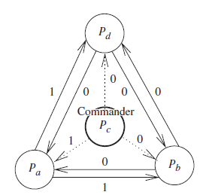
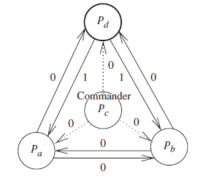
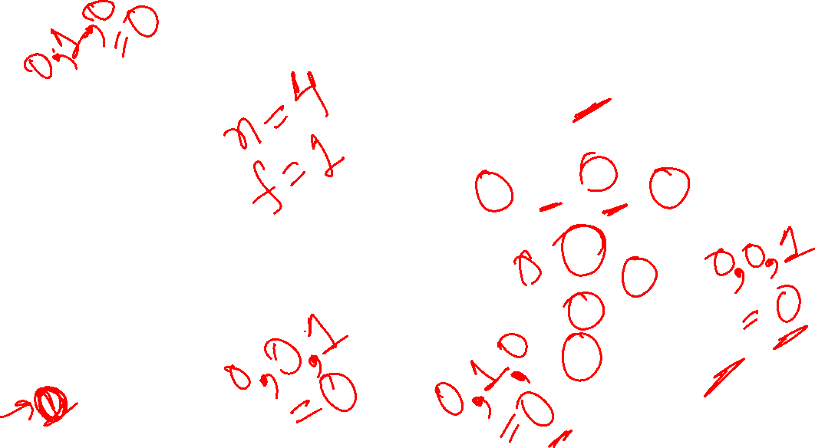
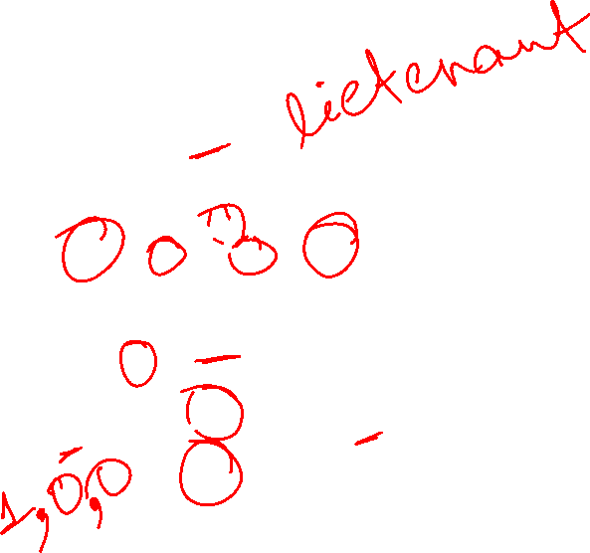
Byzantine Agreement Tree Algorithm: Synchronous System

Slide 20

Byzantine Agreement Tree Algorithm: Recursive Formulation
4
p₁
p₂
4
4
p₃
p₄

Slide 21
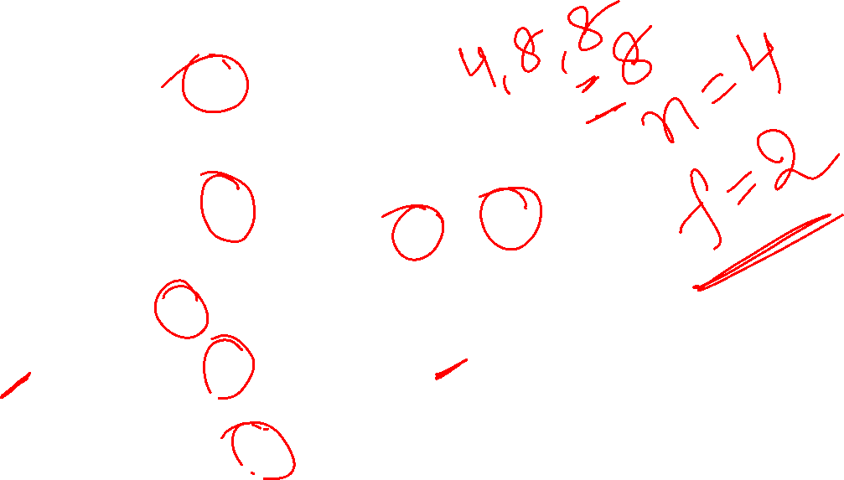
Byzantine Agreement Tree Algorithm: Recursive Formulation
p₁
4
p₂
4
8
8
4
4
4
p₃
p₄
8
4

Slide 22

Byzantine Agreement Tree Algorithm: Recursive Formulation
Oral Message algorithm, OM(f) consists of f+1 “phases/rounds”
Algorithm OM(0) is the “base case” (no faults)
Commander sends value to every lieutenant
Each lieutenant uses value received from commander, or a default value if no value was received
Recursive algorithm OM(f) handles up to f faults
Commander sends value to every lieutenant
For each lieutenant i, let v_{i} be the value i received from commander, or a default value if no value was received. Lieutenant i acts as commander and runs Alg OM(f -1) to send v_{i} to each of the n-2 other lieutenants
For each i, and each j not equal to i, let v_{j} be the value lieutenant i received from lieutenant j in step (2) (using Alg OM(f-1)), or else a default value if no such value was received. Lieutenant i uses the value majority(v₁, … , v_{n-1}) to compute the agreed upon value.

Slide 23
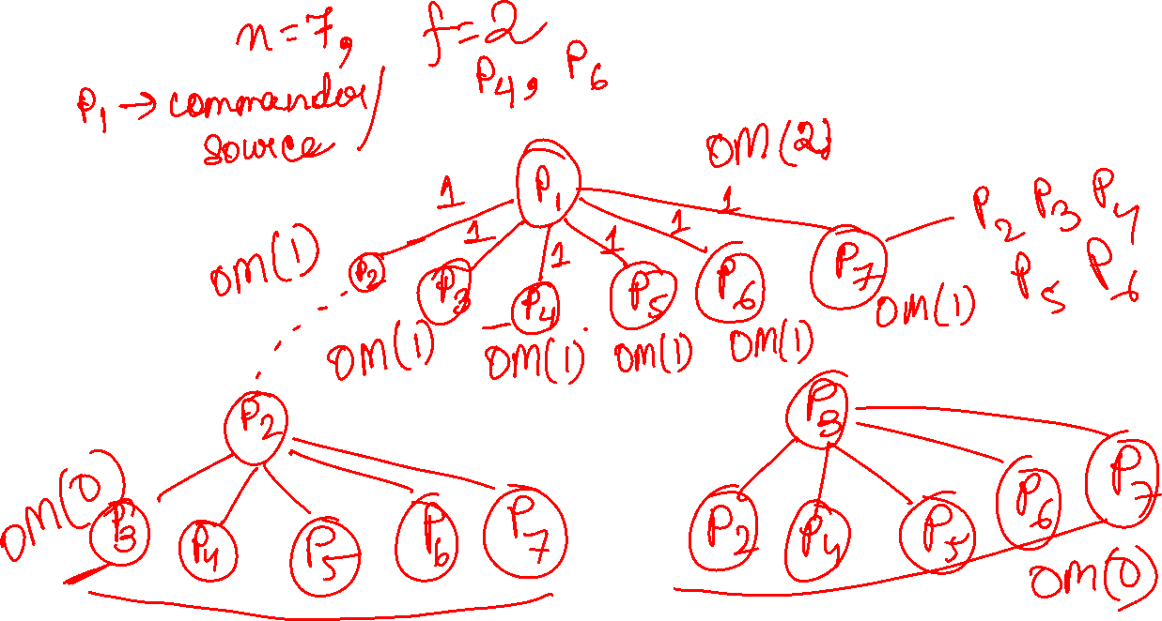

Slide 24

Byzantine Agreement Tree Algorithm: Recursive Formulation
Round number | A message has already visited | Aims to tolerate these many failures | Each message gets sent to | Total number of messages in round
1 | 1 | f | n-1 | n-1
2 | 2 | f-1 | n-2 | (n-1)(n-2)
… | … | … | … | ..
x | x | (f+1)-x | n-x | (n-1)(n-2)…(n-x)
x+1 | x+1 | (f+1)-x-1 | n-x-1 | (n-1)(n-2)…(n-x-1)
… | … | … | … | …
f+1 | f+1 | 0 | n-f-1 | (n-1)(n-2)…(n-f-1)
exponential number of messages O(n^{f}) used

Slide 25
Reference
Ajay D. Kshemkalyani, and Mukesh Singhal, Chapter 14, “Distributed Computing: Principles, Algorithms, and Systems”, Cambridge University Press, 2008.

Slide 26
Thank You

